Slide 1

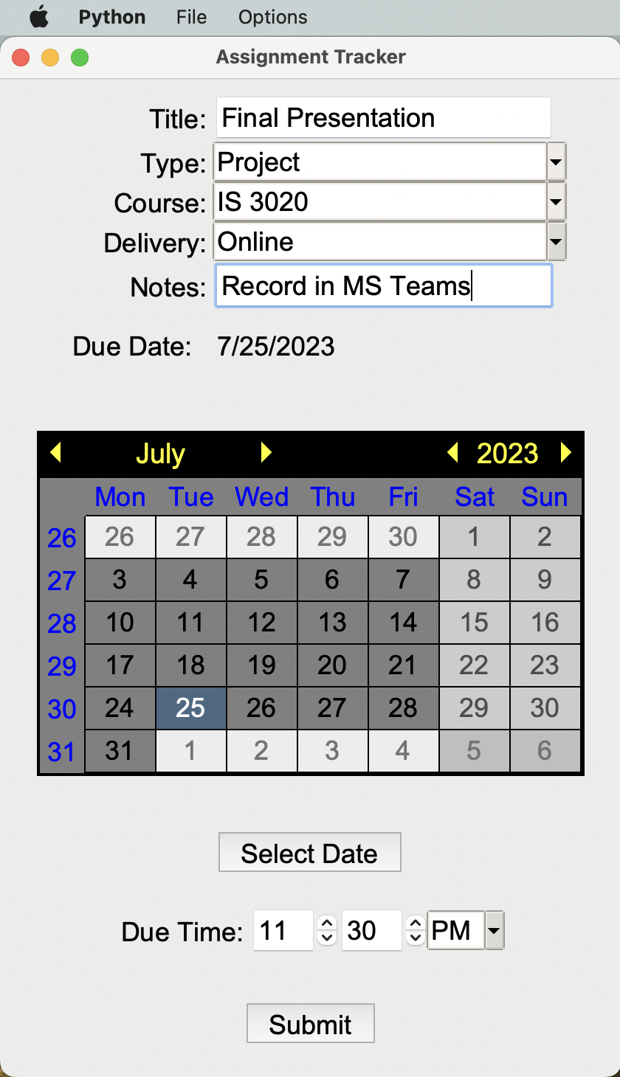

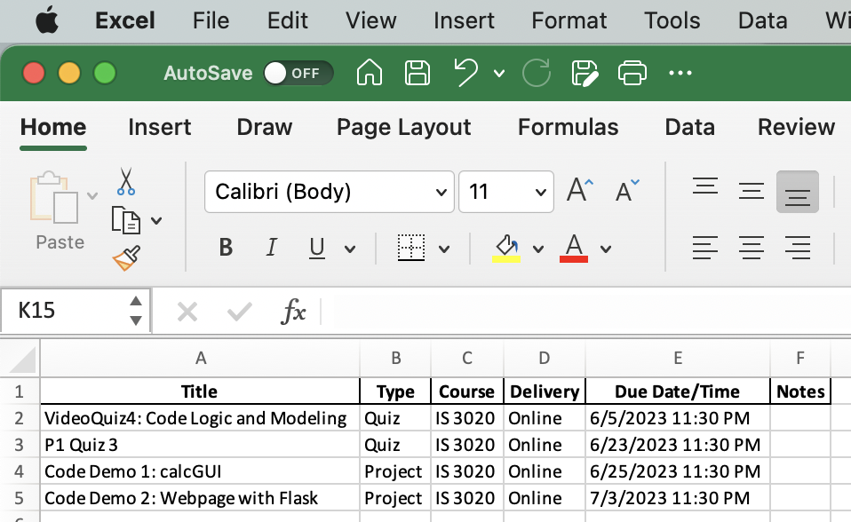
Assignment Tracker
Having trouble keeping your classwork organized? No worries! Create a functional academic planner in Excel with Assignment Tracker – all you need to do is enter the information from your syllabi.
Team Member: Kaitlyn Morgan
GitHub Repo: ksu-is/assignment_tracker

